Slide 1
Ridbul - DRIVEIT

Slide 2
Ask for application access
Report application issue
Ask for application support

Slide 3
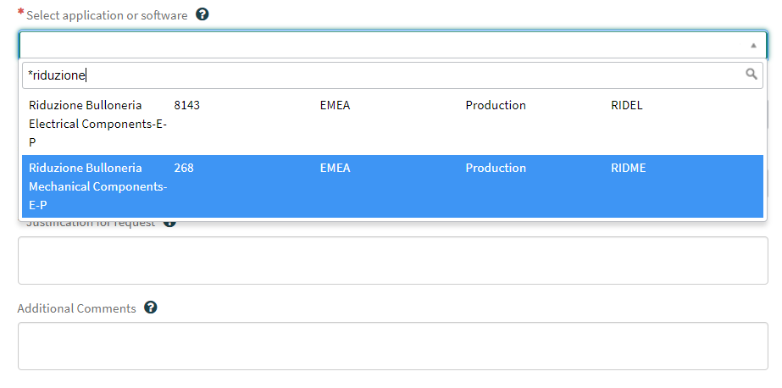
DRIVEIT - ask for RIDBUL application access
In DRIVE IT (https://fiatchrysler.service-now.com/driveit) please select the option :
Request Something →Access →Application Access
Fill the field Select Application or Software
For MECHANICAL / FASTENERS COMPONENTS CATALOGUE
selecting : RIDUZIONE BULLONERIA MECHANICAL COMPONENTS-E-P
For ELECTRICAL COMPONENTS CATALOGUE
selecting : RIDUZIONE BULLONERIA ELECTRICAL COMPONENTS-E-P
In the description field please write the reason for the request and your role.
If you need access for both the catalogues you have to open two different requests
The access request has to be approved by the requester’s direct manager and
by the Application’s Business reference
3

Slide 4
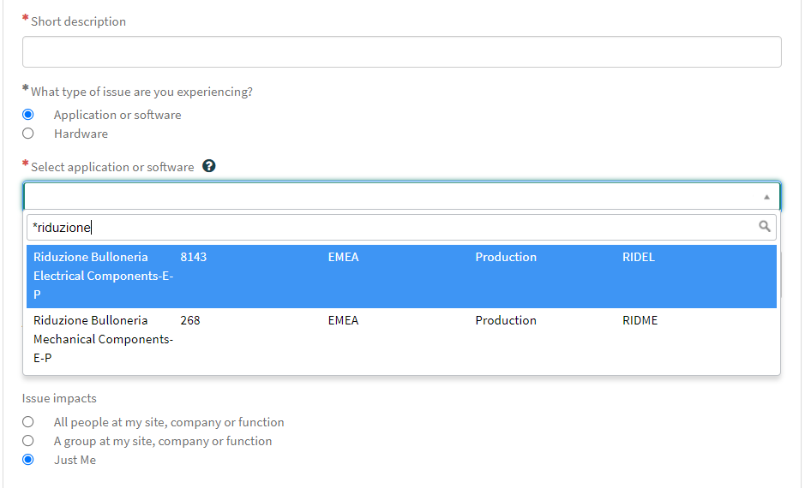
DRIVEIT – report application issue
In DRIVE IT (https://fiatchrysler.service-now.com/driveit) please select the option :
Report an issue
Fill the field Application or Software
For MECHANICAL / FASTENERS COMPONENTS CATALOGUE
selecting : RIDUZIONE BULLONERIA MECHANICAL COMPONENTS-E-P
For ELECTRICAL COMPONENTS CATALOGUE
selecting : RIDUZIONE BULLONERIA ELECTRICAL COMPONENTS-E-P
4

Slide 5
DRIVEIT - ask for application support
In DRIVE IT (https://fiatchrysler.service-now.com/driveit) please select the option :
Request Something →Software and Application → Application Support
Fill the field Select Application or Software
For MECHANICAL / FASTENERS COMPONENTS CATALOGUE
selecting : RIDUZIONE BULLONERIA MECHANICAL COMPONENTS-E-P
For ELECTRICAL COMPONENTS CATALOGUE
selecting : RIDUZIONE BULLONERIA ELECTRICAL COMPONENTS-E-P
5

